Slide 1




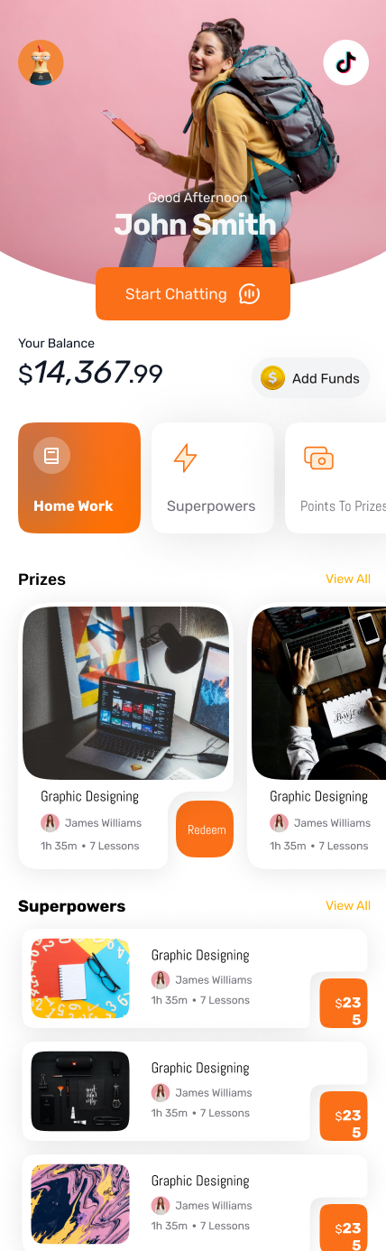

The Inside View
Notes:
Welcome to the Dumo app by Quantum Intelligence.
Here's a guide on how to have a conversation with a prospect on the Dumo app.

Slide 2

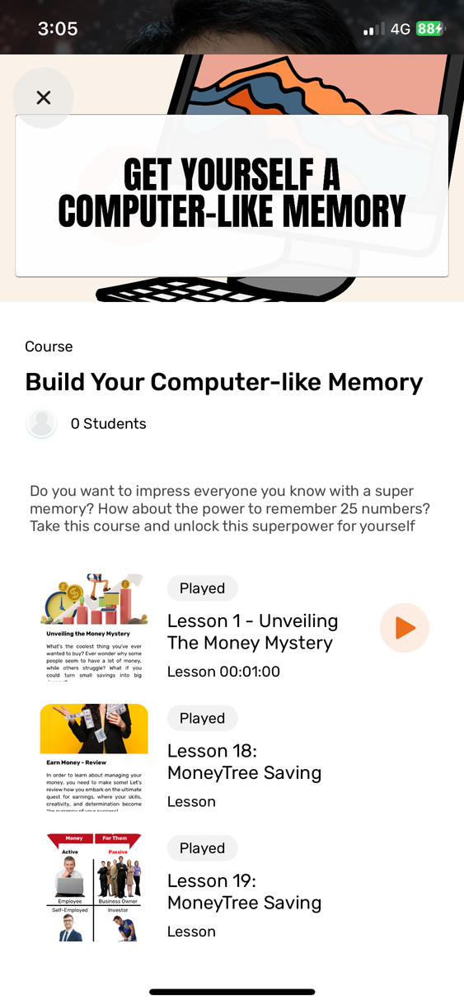
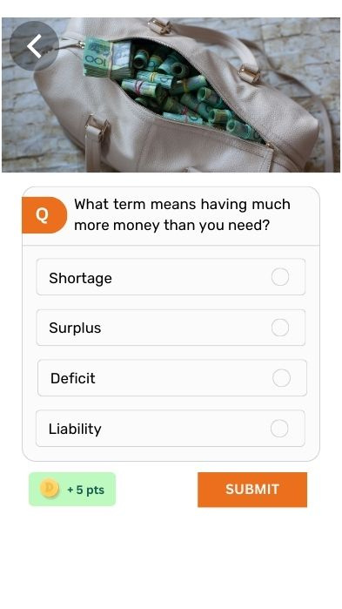
Learning a Superpower
Notes:
Here are some talking points for this slide:
- The DUMO app is designed to give kids superpowers for bright and secure future
- Lessons on the app cover Financial Literacy, Accelerated Learning and Joyfulness
About the lessons:
- Designed to be short and concise
- They feel pleasant for the kids to look at
- Short lessons, kids don't spend too much time learning something new
- Courses are packaged making them relevant to the kids
- Kids will see a reason to learn them

Slide 3

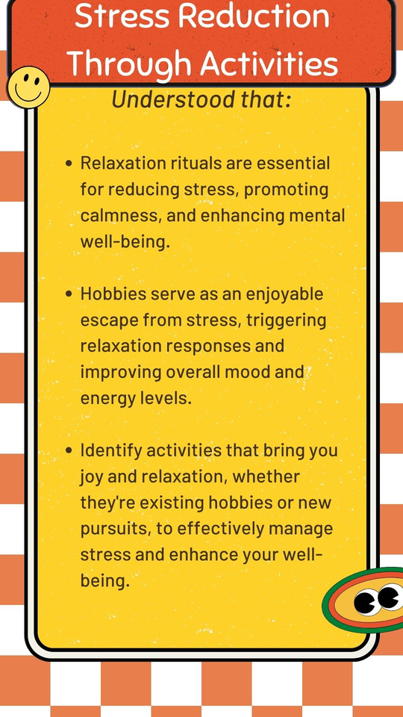
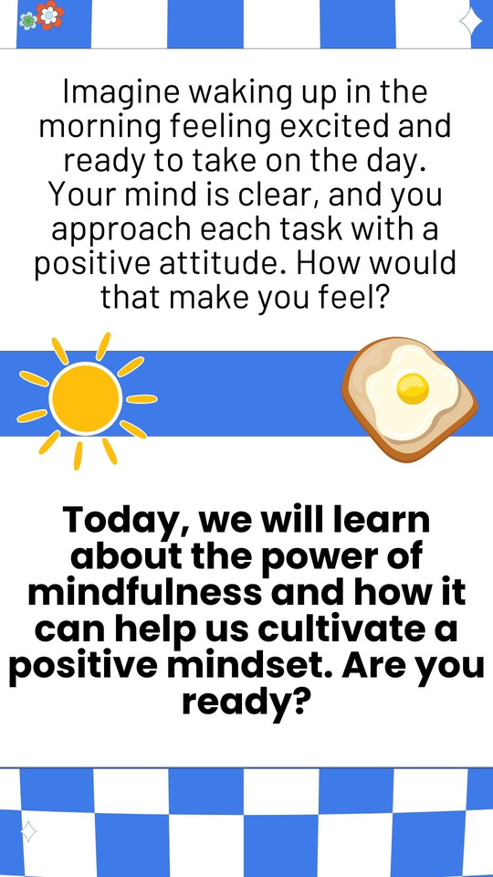
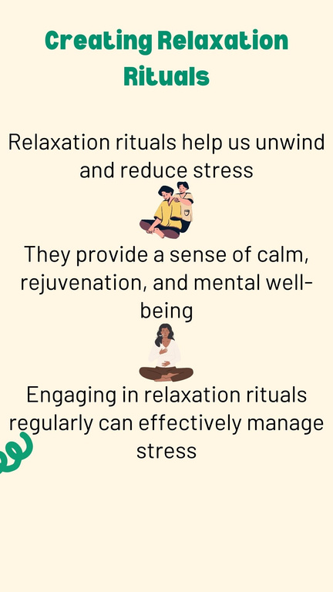


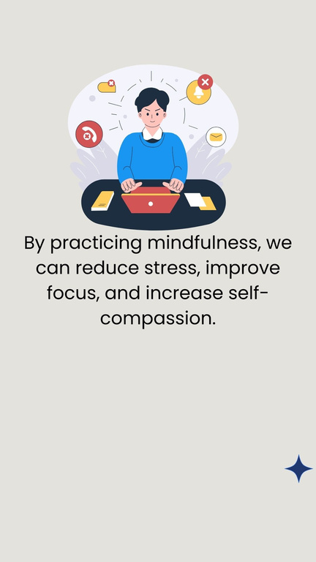
Joyfulness
Notes:
On this slide, you can highlight to parents the importance of joyfulness in the lives of their children
Some talking points include:
- Stress that children face in school
- How mindfulness is important
- How managing their emotions during stressful situations are important

Slide 4
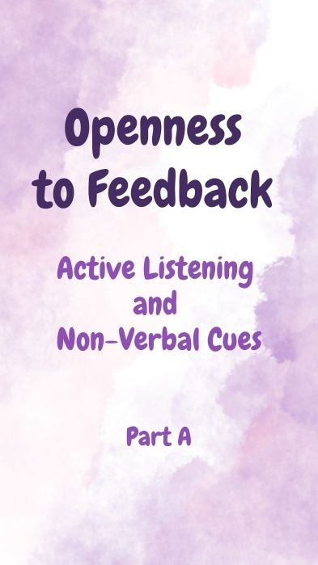
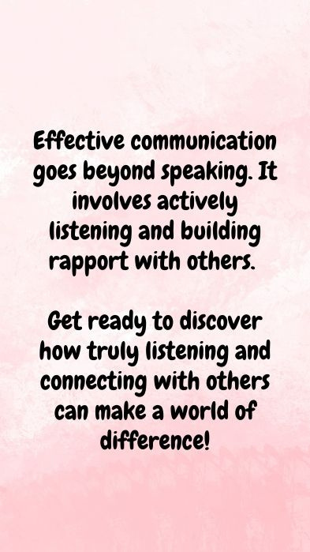
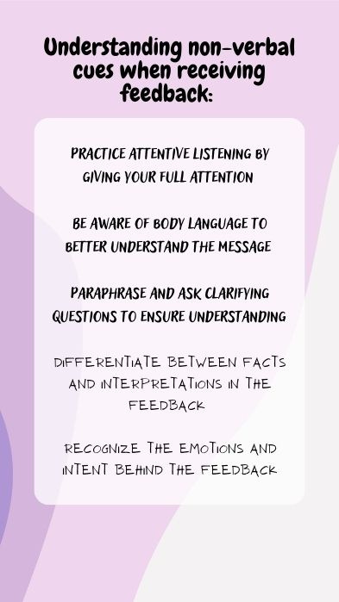
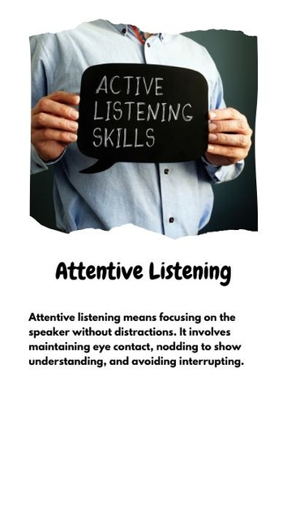
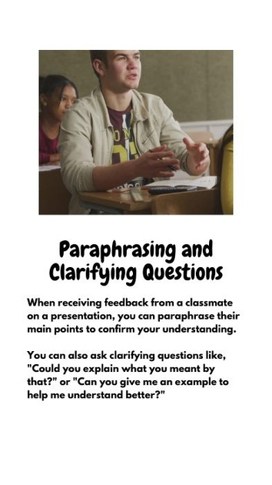
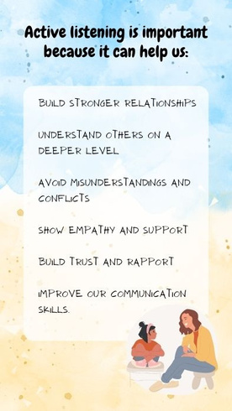

Accelerated Learning
Notes:
On this slide, highlight how accelerated learning will benefit children
Some talking points include:
- Children can learn more in less time
- Encourages children to keep up with technology
- Teach children how to think out of the box more independently and be resourceful

Slide 5

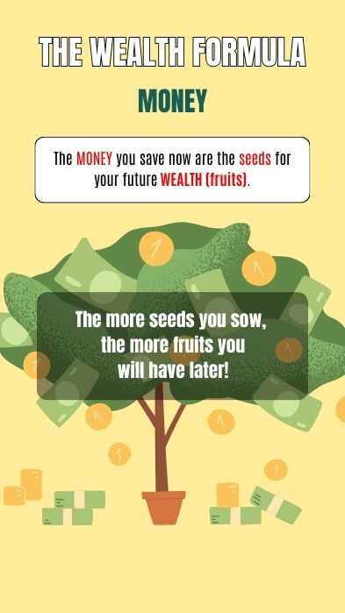
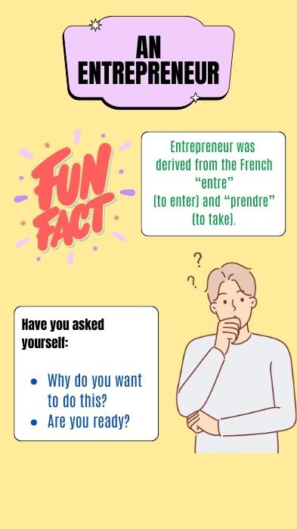

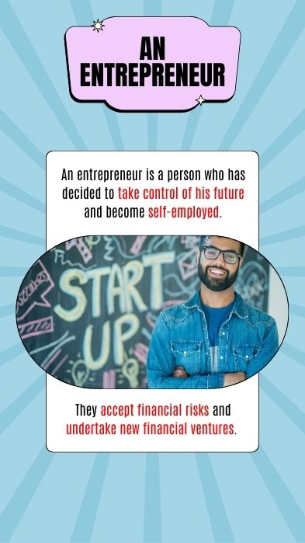

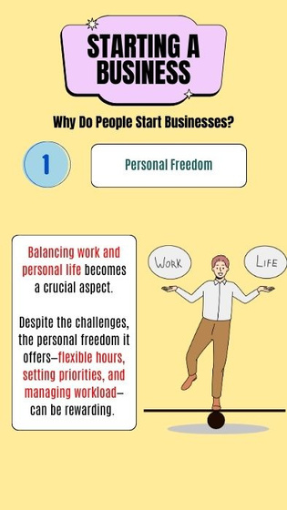
Financial Literacy
Notes:
On this slide, you can talk about the importance of fostering financial literacy in children.
Here are a few talking points:
- It's important to teach children how to manage their finances in the future
- Children need to know how to identify and avoid financial scams online
- Children need to know the importance of saving for the retirement and emergencies

Slide 6
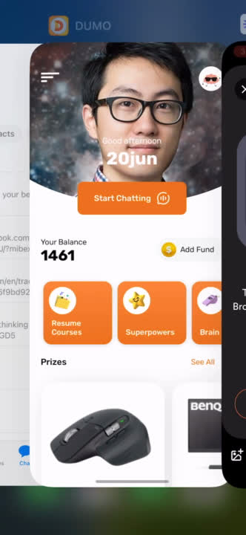
Talking to their A.I. Bot
Notes:
On this slide, you can talk about the presence of the AI Bot on the app.
- AI bot is a companion for learning
- The bot adopts the child's interests
- They can choose the persona of the bot based on their interest
- Give example of a child that likes to cook. They can choose a bot which has the persona of a chef.
- The idea is for the bot to share same interests of the kid so the kid feels comfortable talking to them
- They can feel like wanting to learn daily when the bot prompts them to
- Children can ask the bot questions

Slide 7
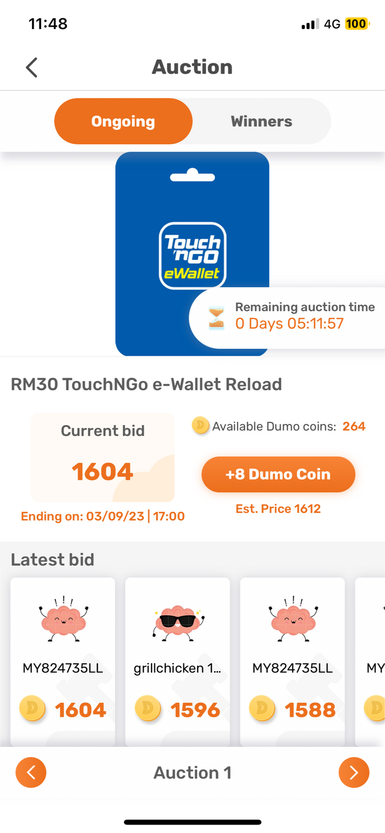
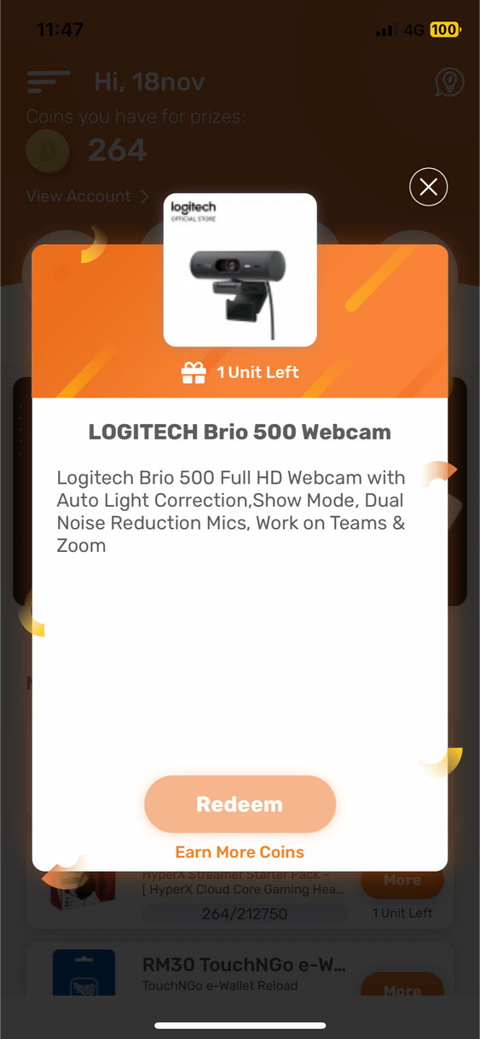
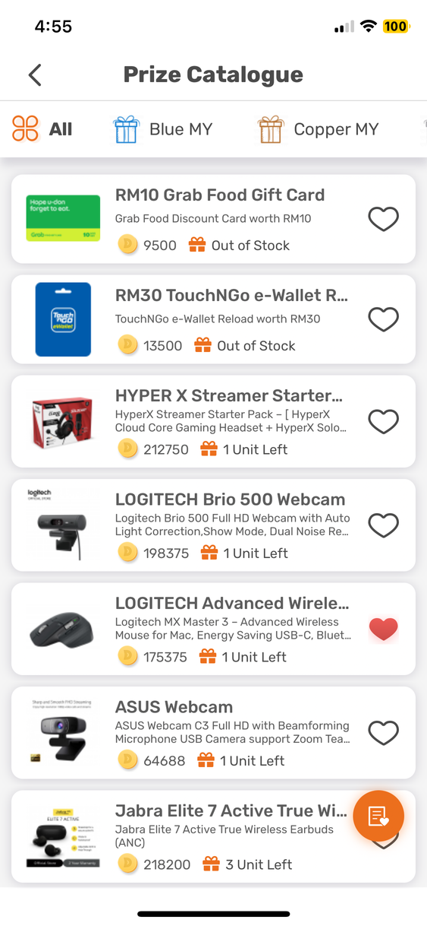
Rewarded for Learning
Notes:
Here you can talk about how the lessons are rewarding for their children.
- Children complete lessons, and earn coins
- Coins are used for the auctions to bid for prizes.
- Prizes are a form of motivation and recognition for children.
- Its a secret to get children to want to learn.
- In the beginning, they will learn to get prizes
- Eventually children will want to learn for themselves instead of for prizes
- Prizes are curated to match what kids now would generally want or need.

Slide 8

Parent’s Dashboard
Notes:
From here, you can move on to the parents dashboard.

Slide 9
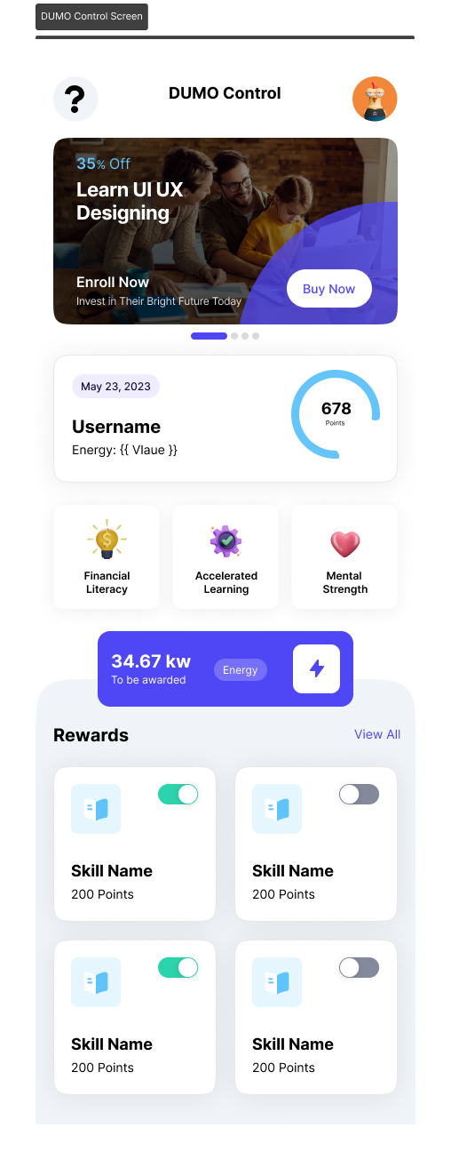
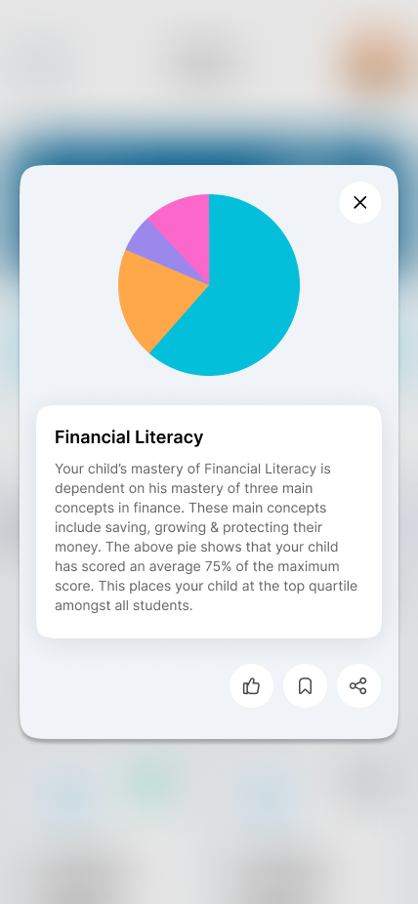
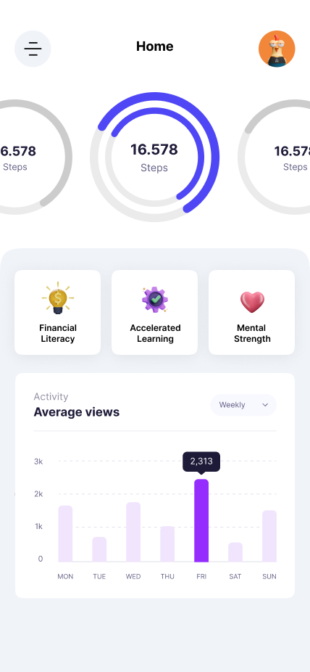
Monitoring your Child
Notes:
On the parents dashboard, you can explain to parents that they can:
- Run diagnostics on their childs learning progress
- Learn about their childs weakness and where they can improve

Slide 10
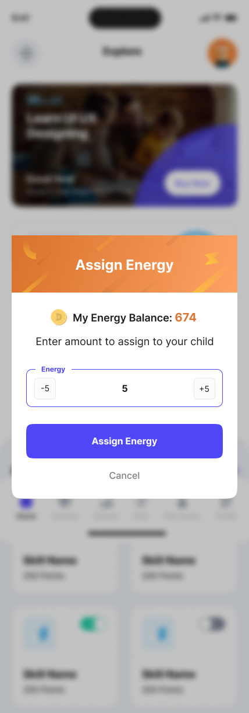
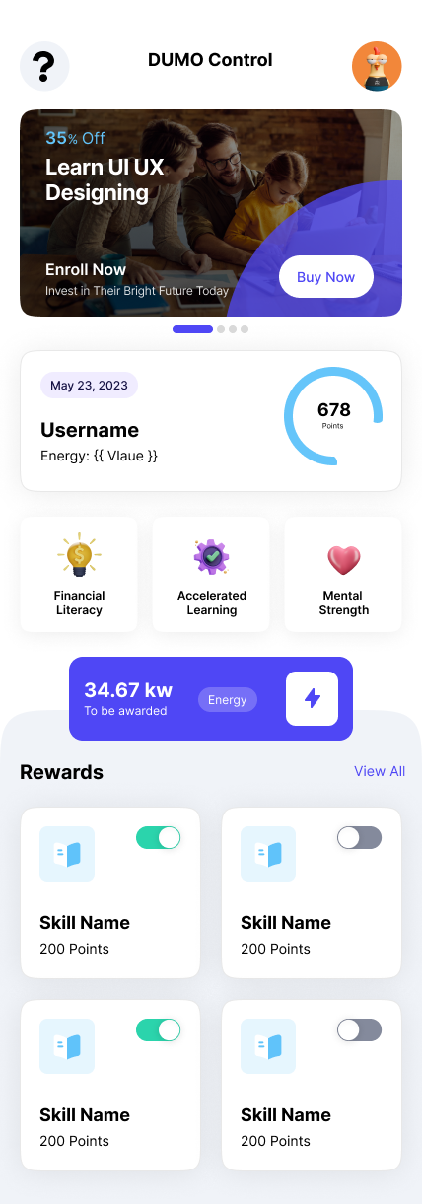
Reward Your Child
Boost Skills
Effective
Communication
Protecting Money
Practicing Mindfulness
Speed Memory Skills
Notes:
On this slide, explain to parents the concept of Energy on the app.
Tell parents they can assign more energy to children in specific areas they want the kids to excel in.

Slide 11
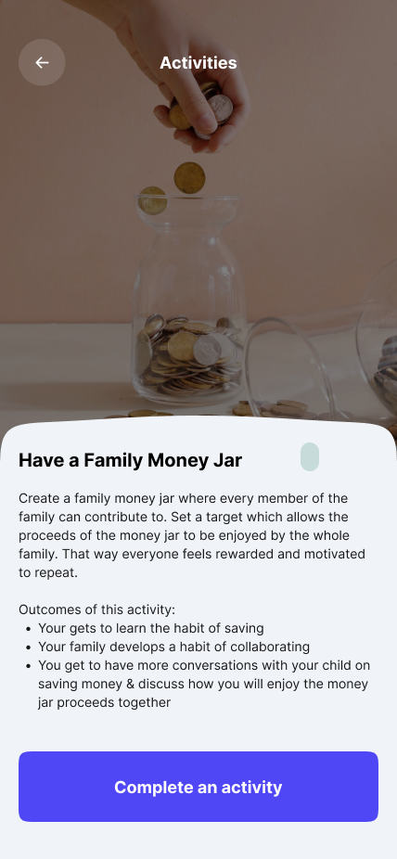
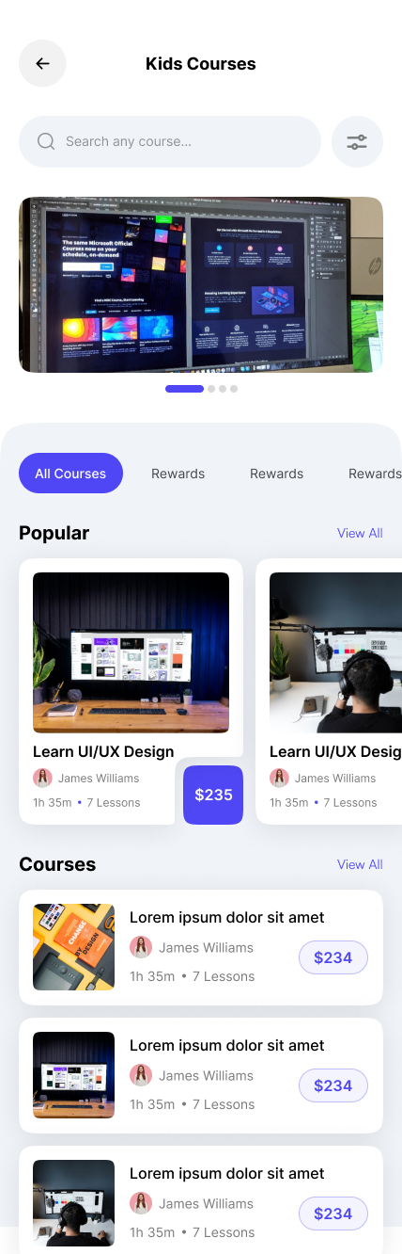
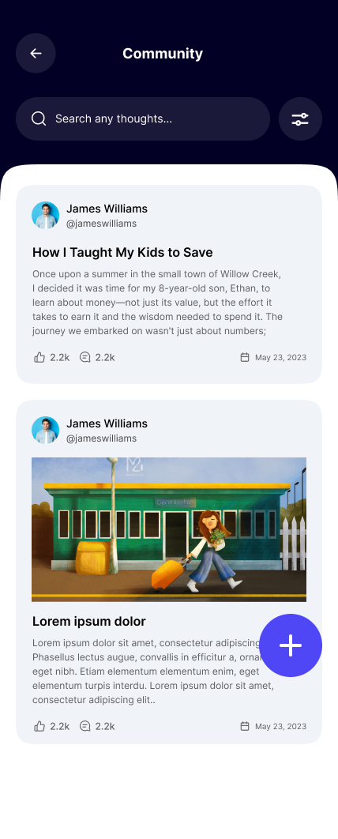
Resources for Parents
Notes:
On this slide, you can talk to parents about the resources available to them
- Relevant articles on new-age parenting
- Podcasts

